Slide 1
Теория Информации
В.Н. Ярмолик
Лекция 8
2017

Slide 2
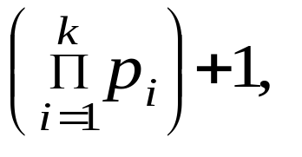
Mathematical Backgrounds Number Theory
The set of Natural Numbers is divided into two subset: Real Number and Integer Numbers. The main subset of numbers to be used in the field of Data Security is the Integer Numbers.
Integer Number d is a divider of n if and only if n=kd. It can be notated as d⏐n. If there is no any k, d is not a divider of n, what can be expressed as d⏐n.
Integer number p, p>1 is the prime number if the only dividers for this number are 1 and p.
Theorem. (Euclid’s) There is infinite set of prime numbers.
Proof: Suppose that this set is finite and consists of the prime numbers p₁, p₂, p₃,…,p_{k}, Then it is the contradiction that the number
is not divided by any of prime number p₁, p₂, p₃,…,p_{k}, thus it is divided by 1 and itself, what means that this number is a prime number. #

Slide 3
Mathematical Backgrounds Number Theory
Theorem. For any big positive integer number k>1, there is a possibility to determine k composite numbers, following in a row within the set of integer numbers.
Proof: The number (k+1)!=2⋅3⋅4 ⋅ … ⋅(k+1) is divided by any of the following numbers 2,3,4,…,(k+1).Thus, the numbers following in a row within the set of integer numbers (k+1)!+2, (k+1)!+3, (k+1)!+4,…, (k+1)!+(k+1), are composite numbers due to the fact that first number is divided by 2, second by 3 and so on. #
Theorem. If the integer number n(n>1) is not divided by any prime number no greater than n^{1/2} means that it is a prime number.
Proof: Suppose that n is a composite number, and can be expressed as n=ab, 1<a<n; 1<b<n. Numbers a and b can not be greater than n^{1/2} simultaneously. #

Slide 4

Mathematical Backgrounds Number Theory
Theorem. (Eratosfen’s)
1) If in a set of integer numbers 2,3,4,..,N, delete all numbers divided by the first r prime numbers 2,3,5,7,…,p_{r}, then the first is not deleted number is a prime number.
2) If in a set of integer numbers 2,3,4,..,N, delete all numbers divided by the prime numbers less or equal to , such a way that p_{r} ≤ ≤ p_{r+1}, then all remaining numbers will be the prime numbers p within the set
2
3
4
5
6
7
8
9
10
11
12
13
14
15
16
17
18
19
20
21
22
23
24
25
26
3
5
7
9
11
13
15
17
19
21
23
25
5
7
11
13
17
19
23
25
7
11
13
17
19
23

Slide 5
Mathematical Backgrounds Number Theory
The distribution of Primes
At the present, the most practical method of selecting primes suitable for use in the RSA algorithm is to test randomly selected integers until the required number of primes have been found. The approach works only because the proportion of primes to non-primes is high enough.
By actual count, one finds that each group of 100 numbers, from 1 to 1000 (1 to 100, 101 to 200, etc.) contains respectively, the following number of primes: 25,21,16,16,17,14,16,14,15,14. In each group of 100 numbers from 1,000,001 to 1,001,000, the corresponding frequency of primes is: 6,10,8,8,7,7,10,5,6,8, and from 10,000,001 to 10,001,000 the corresponding frequency is 2,6,6,6,5,4,7,10,9,6.

Slide 6
Mathematical Backgrounds Number Theory
# | 1 -1000
25 | 1-100
21 | 101-200
16 | 201-300
16 | 301-400
17 | 401-500
14 | 501-600
16 | 601-700
14 | 701-800
15 | 801-900
14 | 901-1000
# | 10 000 001-10 001 000
2 | 10 000 001-10 000 100
6 | 10 000 101-10 000 200
6 | 10 000 201-10 000 300
6 | 10 000 301-10 000 400
5 | 10 000 401-10 000 500
4 | 10 000 501-10 000 600
7 | 10 000 601-10 000 700
10 | 10 000 701-10 000 800
9 | 10 000 801-10 000 900
6 | 10 000 901-10 001 000

Slide 7
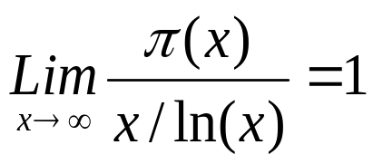
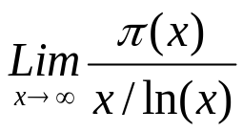
Mathematical Backgrounds Number Theory
According to the prime number theorem, the ratio of π(x), the number of primes in the interval from 2 to x and x/ln(x) approaches 1 as x becomes very large, that is
Where ln(x) is the natural logarithm of x.
x | π(x) | x/ln(x)
1,000 | 168 | 145 | 1.159
100,000 | 9,592 | 8,686 | 1.104
10,000,000 | 664,579 | 620,421 | 1.071
1,000,000,000 | 50,847,476 | 48,254,942 | 1.054

Slide 8
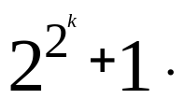
Mathematical Backgrounds Number Theory
Fermat’s prime numbers: 3, 5, 17, 257, 65537, generated by the equation
Euler’s prime numbers can be generated according to the equation x²-x+41, for all integer x, 0≤x≤40.
A Mersenne prime is a Mersenne number that is prime. It is known that if 2^{p} − 1 is prime then p is prime.
(2^{ab}-1)=(2ª-1)(1+2ª+2^{2a}+2^{3a}+…+2^{(b-1)a})
Mersenne prime numbers can be generated according to 2^{p}-1
For prime p=2,3,5,7,13,17,19,31,61.

Slide 9

Mathematical Backgrounds Number Theory
47 Mersenne primes are known. The largest known prime number (2⁴³ ¹¹² ⁶⁰⁹ − 1) is a Mersenne prime (October 2009).
Since 1997, all newly-found Mersenne primes have been discovered by the "Great Internet Mersenne Prime Search” (GIMPS), a distributed computing project on the Internet.
One of the the greatest known prime number is a Mersenne (35) number with 420921 digits.

Slide 10
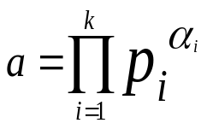
Mathematical Backgrounds Number Theory
Composite numbers can be represented in a canonical form
where p_{i} are the prime numbers.
Example. a=120=2³·3¹·5¹
Common Divisor of the numbers a₁,a₂,a₃,…,a_{n}, is an integer d, that d⏐a₁, d⏐a₂, d⏐a₃,…, d⏐a_{n}.
Greatest Common Divisor of the numbers a₁,a₂,a₃,…,a_{n}, is a greatest integer divisor d, that can be divided by any common divisor of this numbers (a₁,a₂,a₃,…,a_{n}) =d.
Example. (6,15,27)=3.

Slide 11
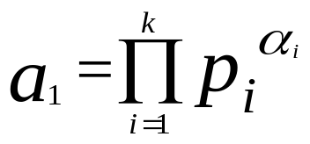
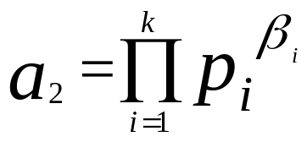
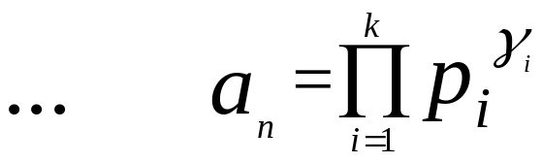
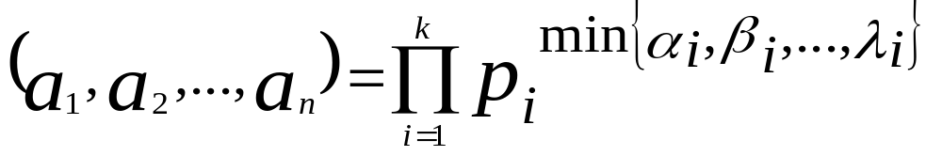

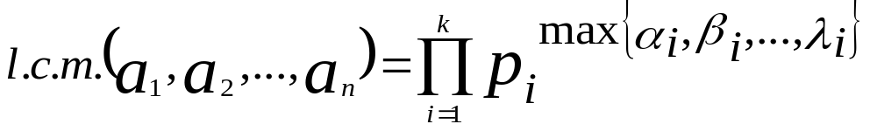
Mathematical Backgrounds Number Theory
Theorem. If
then the greatest common divisor (g.c.d.) is
Example. If 6=2¹·3¹·5⁰, 15= 2⁰·3¹·5¹, 27= 2⁰·3³·5⁰, then (6,15,27)= =2^{min{1,0,0}}·3^{min{1,1,3}} ·5^{min{0,1,0}}=2⁰ ·3¹ ·5⁰=3.
Theorem. If
then the least common multiplier (l.c.m.) is
Example. If 6=2¹·3¹, 15= 3¹·5¹, 27= 3³, then l.c.m.(6,15,27)= =2^{max{1,0,0}}·3^{max{1,1,3}} ·5^{max{0,1,0}}=2¹ ·3³ ·5¹=270.

Slide 12
Mathematical Backgrounds Number Theory
Theorem. If a=bq+r, then (a,b)=(b,r).
Proof: Let d=(a,b), then from the statement that d⏐a and d⏐b we can conclude that d is a divider for a-bq=r.#
Theorem. (Euclid Algorithm) For any integer numbers a>0 and b>0 that a>b, and b is not a divider of a for some s exists integer numbers q₀,q₁,q₂,…,q_{s} and r₀,r₁,r₂,…,r_{s} that b>r₀>r₁>r₂>…>r_{s} >0 and a=bq₀+r₁, b=r₁q₁+r₂ , r₁= r₂q₂+r₃,…, r_{s-2}= r_{s-1}q_{s-1}+r_{s}, r_{s-1}= r_{s}q_{s} and (a,b)=r_{s}
Euclid’s Algorithm
begin
g₀:=a; g₁:=b;
i=1;
while g_{i}≠0 do
begin
g_{i+1}:= g_{i-1} mod g_{i};
i:=i+1;
end
gcd:= g_{i-1} {gcd-Greatest Common Divisor}
end

Slide 13
Mathematical Backgrounds Number Theory
Example. Determine the greatest common divisor for integers 1173 and 323, (1173,323)=?.
Solution: 1173=323·3+204; 323=204·1+119; 204=119 ·1+85; 119=85·1+34; 85=34·2+17; 34=17·2;
g_{i+1}:= g_{i-1} mod g_{i};
204:=1173 mod 323;
119:=323 mod 204;
85:=204 mod 119;
34:=119 mod 85;
17:=85 mod 34;
0:=34 mod 17.

Slide 14
Mathematical Backgrounds Number Theory
Binary Algorithm This algorithm is an extension of Euclid’s Algorithm and is based on the following statements:
1. If both a and b are even, then (a,b)=2(a/2,b/2);
2.If a even, and b odd, then (a,b)=(a/2,b);
3.According to the last Theorem (a,b)=(b,a-b);
4.If both a and b are odd, then a-b is even.
Example. Determine the greatest common divisor for integers 1173 and 323, (1173,323)=?.
Solution: (1173,323)=(323,850)=(323,425)=(323,102)=(323,51)=(51,272) =(51,136)=(51,68)=(51,34)=(51,17)=(17,34)=(17,17)=17.

